Slide 1

Physical Education 101
Class 4: Cardiovascular endurance

Slide 2
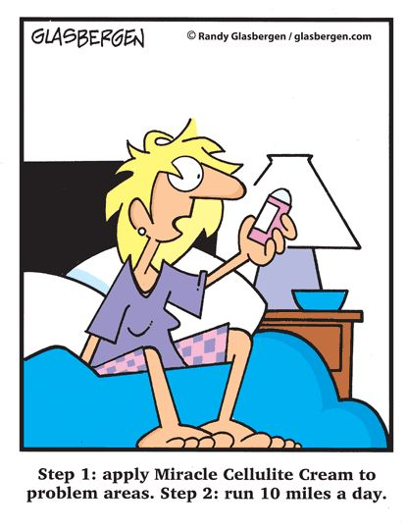
CARDIOVASCULAR ENDURANCE
Definition: The ability to perform activities using the large muscles of your body, of moderate-hard intensity, for long periods of time.

Slide 3
Benefits of Developing Your Cardiovascular Endurance:
improves your circulation
lowers your resting heart rate
**helps to lower your body fat
improves your muscular endurance (+ potentially strength in most recent research)
helps to lower your stress levels
improves the efficiency of your immune system

Slide 4

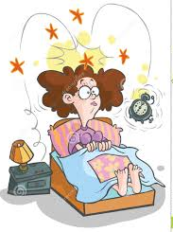
What is Resting heart rate?
It is how many times your heart beats in 1 minute, while at rest.
The best time to check your resting heart rate is in the morning before getting out of bed. (Ideally in conditions like the picture on top):

Slide 5
What's a normal resting heart rate?
Most adults have a resting heart rate between 60 and 100 bpm (beats per minute).
The fitter you are, the lower your resting heart rate is likely to be.
There are athletes that have a resting heart rate of 40 to 60 bpm.
Pulse Check- (feel the carotid artery in either side of your neck)

Slide 6
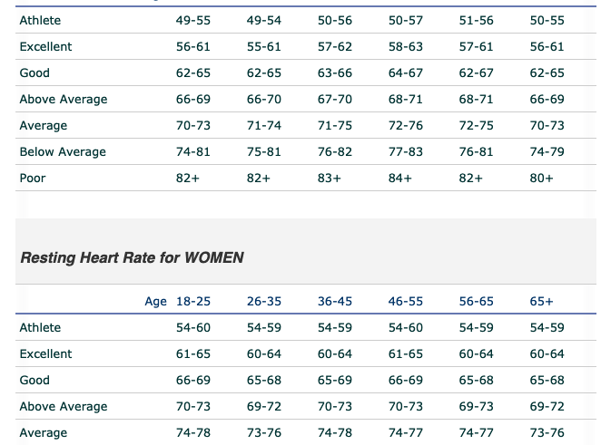

Slide 7
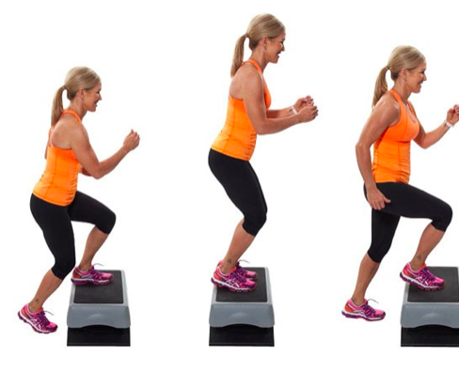
Cardio Tests
Submaximal Test vs. Maximal Test: Pros & Cons
Beep Test: Maximal
Step Test: Submaximal

Slide 8
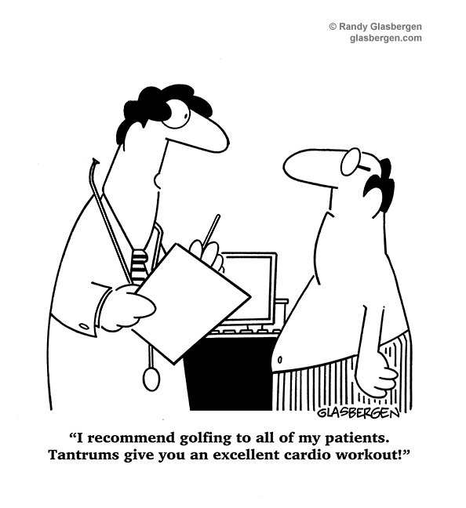
Sports
Can be a great form of cardio as long as it is not skill based.

Slide 9
How to improve your Cardiovascular Endurance Using The FITT Principle:
Frequency: 3-5 times a week
Intensity: 60-85 % of your maximum heart rate or at least Moderate-vigorous on the Borg Scale.
Time: 30 minutes or more (with your heart rate in the target heart rate zone)
Type of Activity: Choose activities that increase your heart rate over an extended period of time.
Examples: running, cycling, cross country skiing, rowing, dancing.

Slide 10
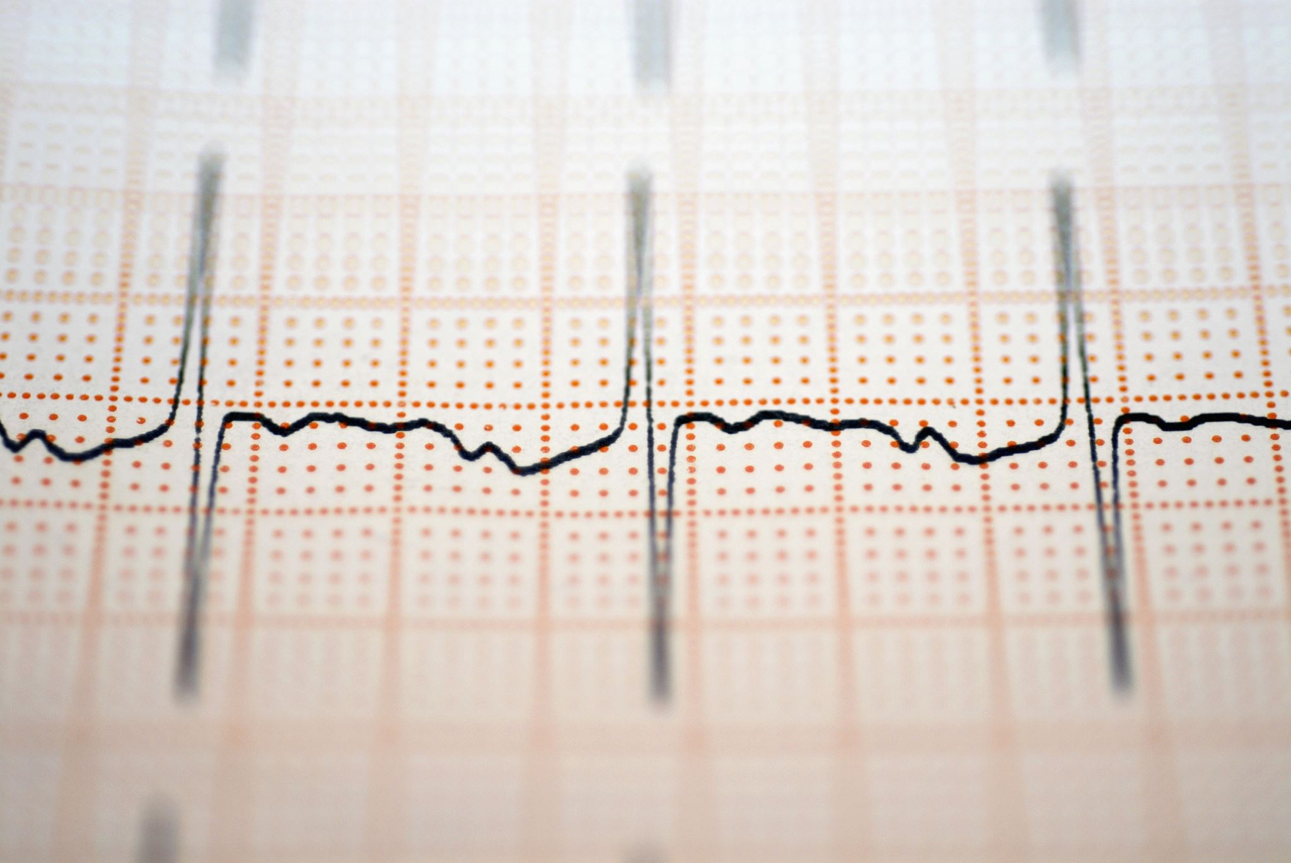
Determining Your Intensity During Aerobic Exercise
Pulse Check- (feel the carotid artery in either side of your neck)
The training zone is the range of heart beats needed to improve your aerobic fitness. This range is 60-85% of your maximum heart rate.
*You can also monitor your heart rate by using the hand sensors on aerobic machines.
*A heart rate monitor (with chest strap or without) is also useful to assess your heart rate.

Slide 11
Heart Rate
Step 1: Determine your Maximum Heart Rate (MHR) : 220 minus your age
Step 2: Multiply your MHR by 60% and by 85%, to determine your training zone.
Lower end of zone = MHR________ x .60 = __________ b/min
Upper end of zone = MHR________ x .85 = __________ b/min

Slide 12
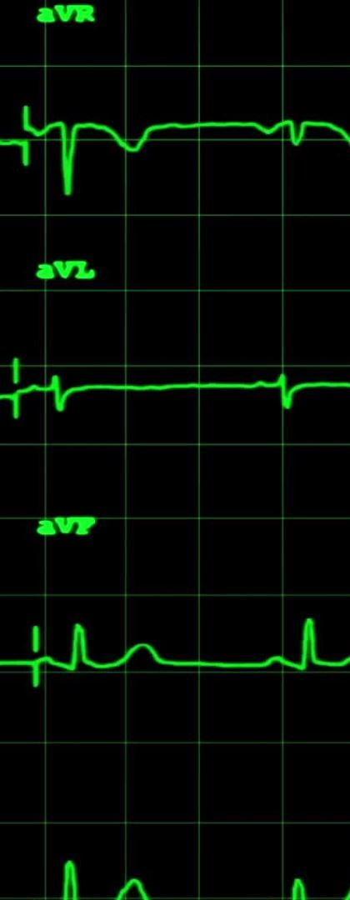
Heart Rate-18 years old
220-18 = 202 Beats Per Minute (BPM)
202 BPM = 100% MHR
Therefore 202 x .6= 121.2 (BPM)= 60%
202 x .85= 171.7= 85%

Slide 13
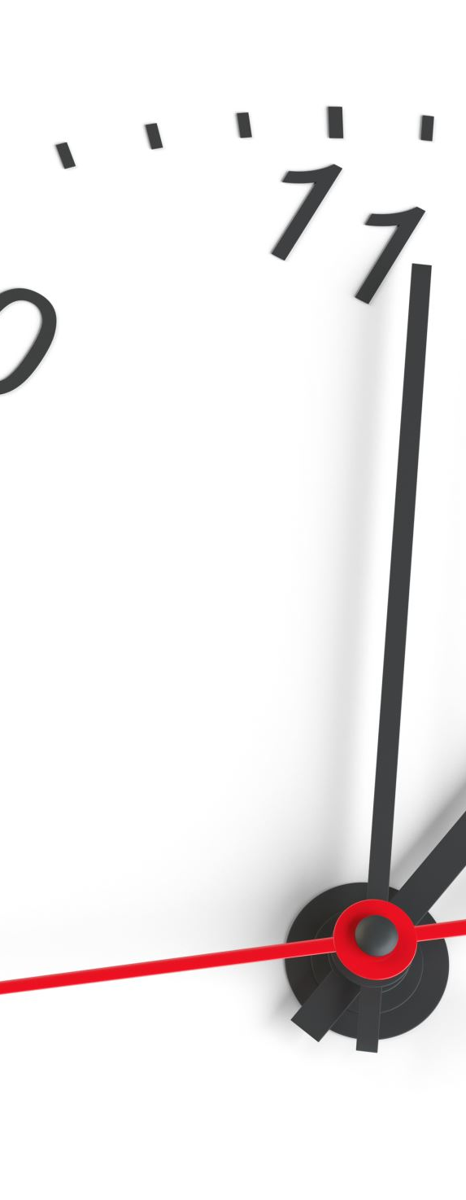
Heart Rate
This means that if you are 18 years old, to ensure that you are getting optimal cardiovascular benefits you need to be working at 121 beats per minute for 20 minutes or more.
In order to not be watching the clock for a full minute, we will divide this number by 4, which will show us our target heart rate over a 15 second window
121.2 ÷ 4 = 30.3 (beats per 15 seconds)

Slide 14
Heart Rate
Therefore, if you take your heart rate in the middle of your workout and you are below 30 beats for 15 seconds, you are not working intense enough to ensure optimal cardiovascular benefits.
* Please remember that this is a theory, and that every body is different. Also, working above your MHR does not necessarily mean that you are at any sort of risk.

Slide 15
Target Heart Rate over 15 seconds
Age | Minimum HR (.60) | Upper Range HR (.85)
18-23 | 30 | 42
24- 29 | 29 | 41
30-35 | 28 | 40

Slide 16
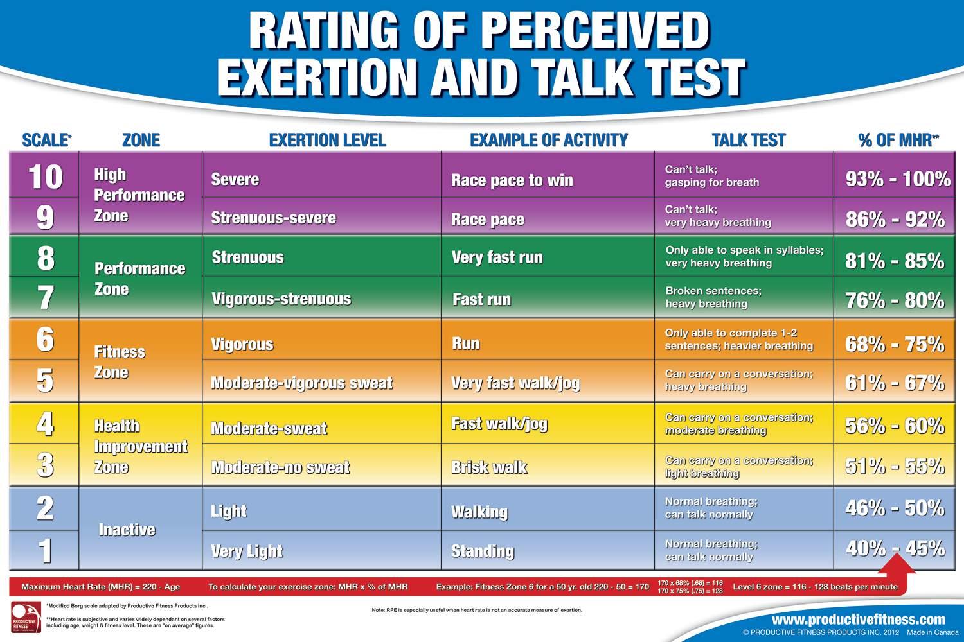
RPE

Slide 17
The Energy Systems
Main Energy System Used | Duration (sec.) | Energy Source
Anaerobic Alactic | Less than 10 sec | ATP / CP stores
Anaerobic Lactic Acid | 10 sec to 2 min. | Mainly Glycogen Stores
Aerobic | 2 min and longer | Glycogen and Fatty Acids

Slide 18
The Energy Systems
1) The anaerobic alactic energy system requires no oxygen, uses energy stored in the cell for fuel, produces no lactic acid and is the main energy source of activity lasting up to 10 sec.
2) The anaerobic lactic energy system requires no oxygen, uses carbohydrate for fuel, produces lactic acid and is the main energy source for activity lasting between 10 sec and 2 minutes.
3) The aerobic energy system needs oxygen, uses fats and carbohydrates for fuel, produces no lactic acid, and is the main source of energy for activity lasting more than 2 minutes.

